Slide 1
Analysis of Variance (ANOVA)
Team 4 - Avery McNamee, Nasiba Radjabova, David Hogarth, Tyler Crist

Slide 2
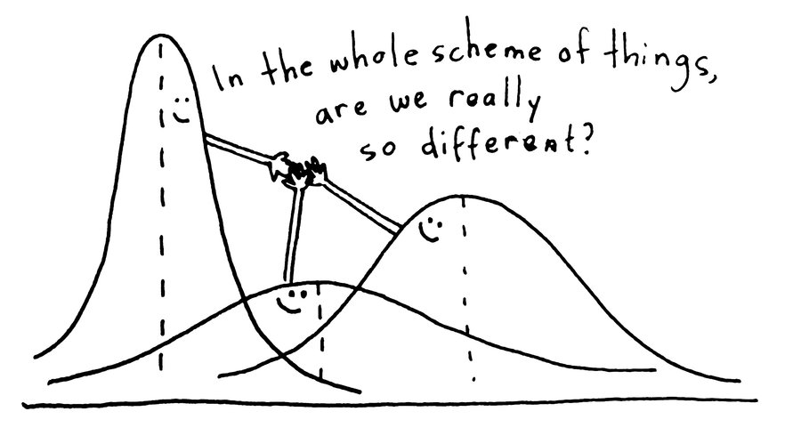
Agenda
ANOVA Introduction
How it works
Interpretation
Example exercise in RStudio
Kahoot!

Slide 3
What is ANOVA?
History of Anova
ANOVA → Analysis of Variance
A comparison of two statistical models.
One of these models is the full model (alternative hypothesis)
The other model is a simpler model that is missing one or more of the terms that the full model includes (null hypothesis)
​
​

Slide 4
How ANOVA Works
Full Model (M1): Y ~ A + B + C + D
Null Model (M0): Y ~ A + B
MS = SS/df
We obtain our F-statistic by contrasting the MS value associated with “the thing we’re interested in” (the model) with the MS value associated with “everything else” (the residuals)
We want to calculate the SS value that is associated with the difference between the two models
SS_{T} = SS_{M} + SS_{R}
Rearranging this: SS_{M} = SS_{T} - SS_{R}
SS_{M0} = SS_{T} - SS_{R0}
SS_{M1} = SS_{T} - SS_{R1}
SS_{Δ}=SS_{M1}−SS_{M0}=(SS_{T}−SS_{R1})−(SS_{T}−SS_{R0})=SS_{R0}−SS_{R1}
Notes:
The null model only contains some subset of the terms in the full model
**we want to see if adding the terms C & D improve our model!
Significant output – we reject the null in favor of the “full model!” – this is essentially the purpose of an ANOVA test

Slide 5



The F-test
MS for the difference between models:
MS for the residuals associated with the full model:
F-statistic:
Notes:
Full model is denoted by R1
The book breaks its down into 3 important equations
The first is the Mean Square difference between models, this looks at the Sum of Squares being divided by the degrees of freedom
The second is the Mean Square for the residuals associated with our Full model and it looks at the Sum of Squares of our R1 divided by the degrees of freedom of our R1
The third is the F Stat, which is taking the first equation at the top, divided by the second equation
All 3 equations help us understand and interpret ANOVA

Slide 6
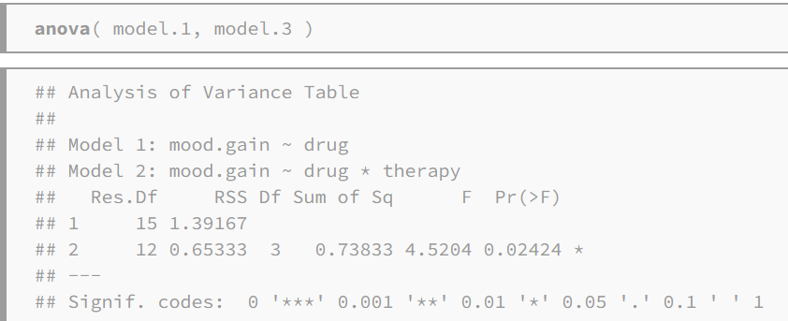
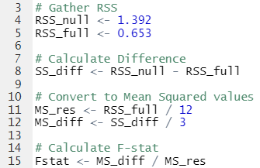
Calculating F-stat: An Exercise in R
F-test and degrees of freedom guide us to our p-value
Significant p-value → reject the null hypothesis
Notes:
Diving deeper into our previous slide, we will explain how to calculate the F-Statistic
The first step is going to be gathering the Residual Sum of Squares
This includes obtaining the RSS from both our Null and our Full model
You can follow along with our screenshot where we got these two numbers from
In the bottom left corner, under RSS you can see 1.392 and .653
Next, we are going to be calculating the difference between the the two RSS figures
To do that, we create a new variable and within that new variable, we create an equation that subtracts the RSS of our NULL from the RSS of our FULL
Following that step, we going convert to the MEAN SQUARED VALUES
We do this by creating two new variables (MS_res and MS_diff)
For MS_res we divide our RSS_FULL by 12 degrees of freedom and
For MS_Diff we divide our RSS_NULL by 3 degrees of freedom
Finally, we can calculate the F STAT
For this step, we create a new variable and divide our MS_diff from the MS_res
On the screenshot you can see under F that we get a score of 4.52
Now looking at the screenshot I want to note two points of emphasis
The first is looking at the F stat and Degrees of freedom and how this will guide us to our p value and
The second would by that if we have a sig p value we will reject the null hypothesis
Now, David is going to dive more into Interpreting ANOVA

Slide 7
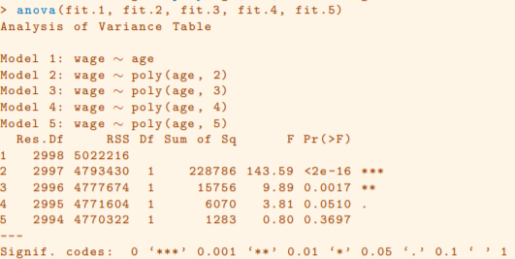
Interpreting ANOVA Output
Notes:
When we reject the null, we say that the second model is better than the first one (put in earlier slide)
Nearly identical to the recent codio exercise - ANOVA with polynomial regression

Slide 8
Kahoot!

Slide 9
References
https://stats.libretexts.org/Bookshelves/Applied_Statistics/Book%3A_Learning_Statistics_with_R_-_A_tutorial_for_Psychology_Students_and_other_Beginners_(Navarro)/16%3A_Factorial_ANOVA/16.05%3A_The___F___test_as_a_model_comparison
https://hastie.su.domains/ISLR2/ISLRv2_website.pdf

